Slide 1

Retail Sales
Analysis
Group 06
Roshan Rawat, Gangothri Gadige, Chandan Kumar,
Narendra Reddy, Faryar Memon

Slide 2
We promise it will be quicker this time😉

Slide 3
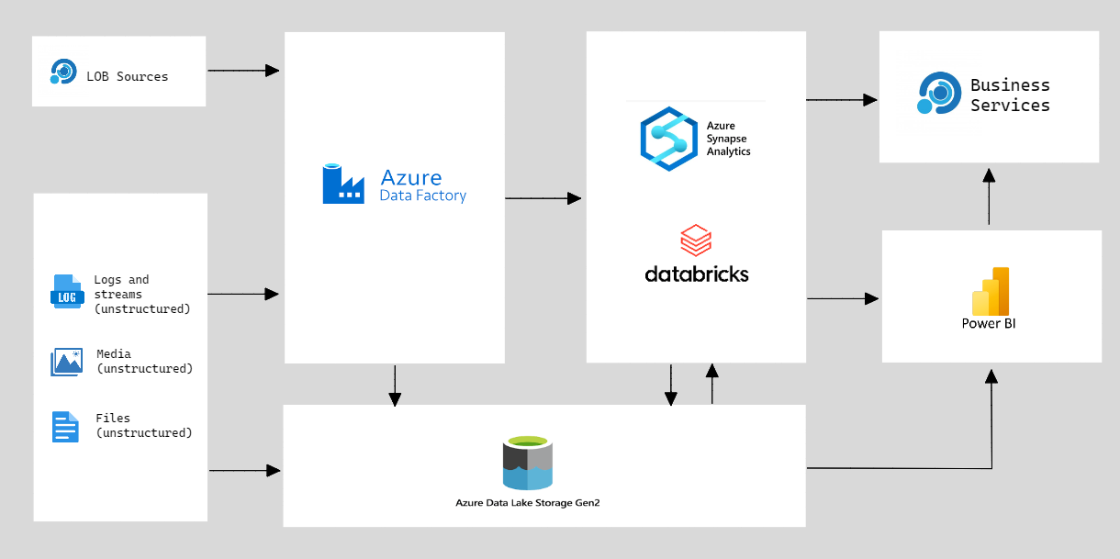
Modern Data Warehouse Architecture

Slide 4

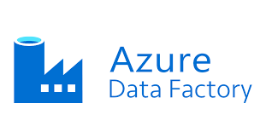
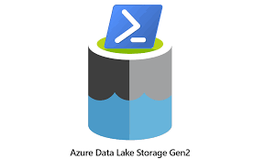



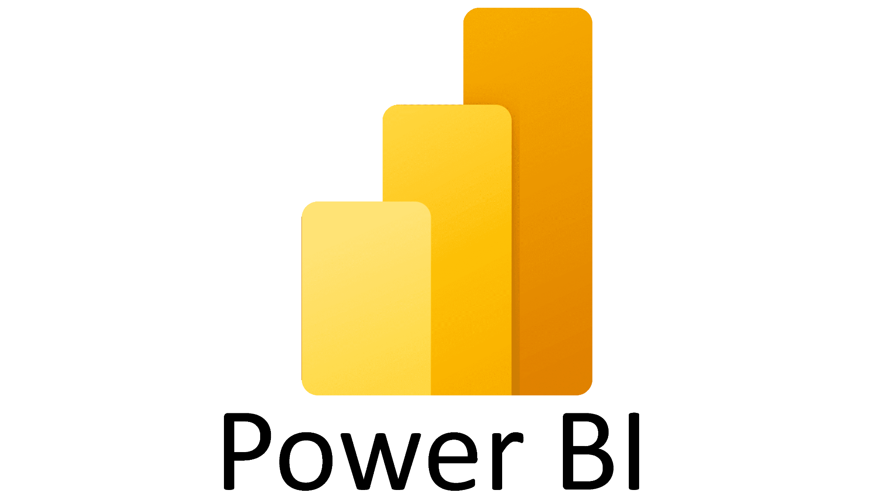
Tasks
Source
Collecting the data from the client source
ETL
Using ADF to ingest data from client source
Azure SQL Database to Azure Data Lake Storage
Analysis
Integrating ADLS with Synapse using Linked
Services & mounting ADLS to Azure Databricks
Visualization
Integrating the analysis results with Power BI
for impactful visualizations and reporting

Slide 5
Our Sub-Teams:
Managed by DE Expert Venkat Sir✨
IAM Team
Data Integration Team
Data Analytics & BI Team
Managing Azure AD resources and access controls, configuring authentication methods and monitoring access activities
Faryar
Roshan
Extracting data from various sources, transforming and loading data into data warehouse; maintaining ETL workflows and pipelines
Gangothri
Roshan
Perform big data analysis and create dashboards to communicate findings
Chandan
Narendra
Roshan
Notes:
Identity and Access Management Team : IAM Team

Slide 6
Why add multiple users to a single Resource Group?
Centralized Access Management
Seamless Collaboration and Resource Sharing
Improved Security
Cost Optimization
This simplifies administration, enhances collaboration, improves security, and optimizes costs
Notes:
Centralized Identity and Access Management: Adding multiple users to a single Azure Active Directory (Azure AD) and granting them access to a single resource group allows for centralized identity and access management. It simplifies user provisioning, authentication, and authorization processes.
Streamlined Administration: Managing users and their access becomes more efficient when they are associated with a single Azure AD and resource group. It reduces administrative overhead, eliminates the need for managing multiple access controls, and promotes consistent security practices.
Enhanced Collaboration and Resource Sharing: By adding multiple users to a single resource group, you enable seamless collaboration and resource sharing. Users within the same Azure AD can work together on shared resources, fostering teamwork and improving productivity.
Improved Security and Compliance: Centralizing user access within a single Azure AD and resource group enables better security control and compliance management. Security policies and access controls can be consistently applied, ensuring data protection and regulatory compliance.
Cost Optimization: Utilizing a single Azure AD and resource group for multiple users helps optimize costs. It reduces the need for multiple subscriptions or resource groups, leading to more efficient resource utilization and potential cost savings.

Slide 7
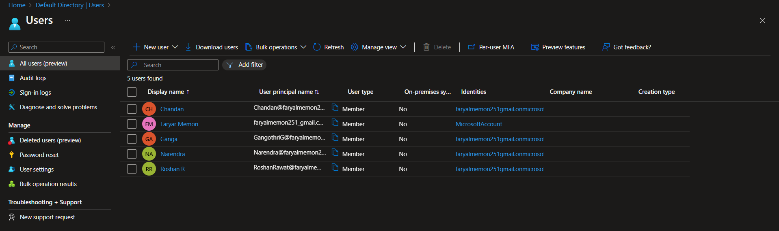
Creating Users Under One Azure Active Directory

Slide 8
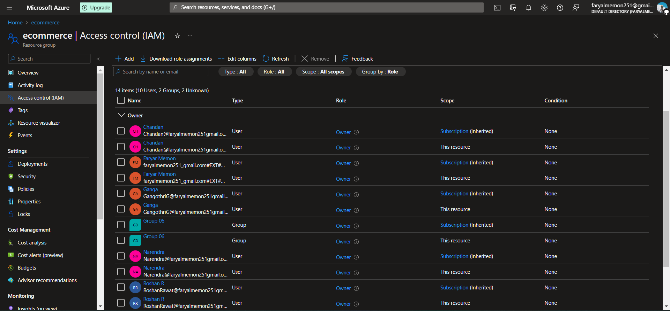
Providing Privileges Resource Group and Subscriptions

Slide 9
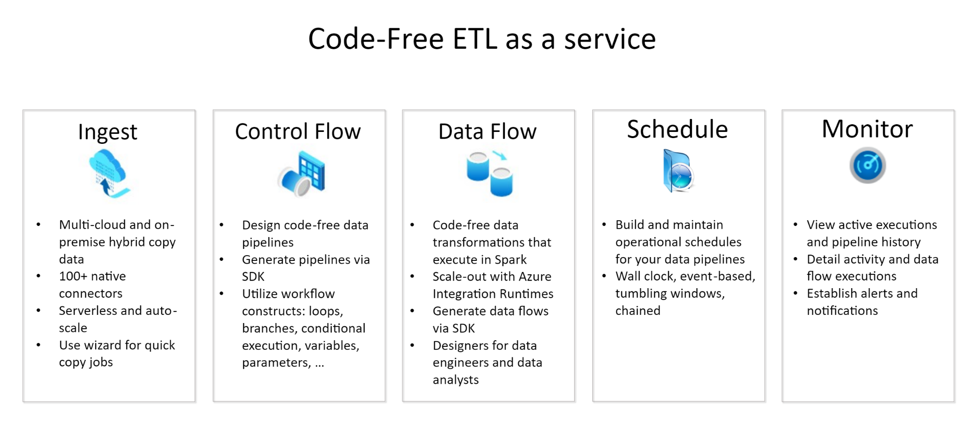
Azure Data Factory

Slide 10
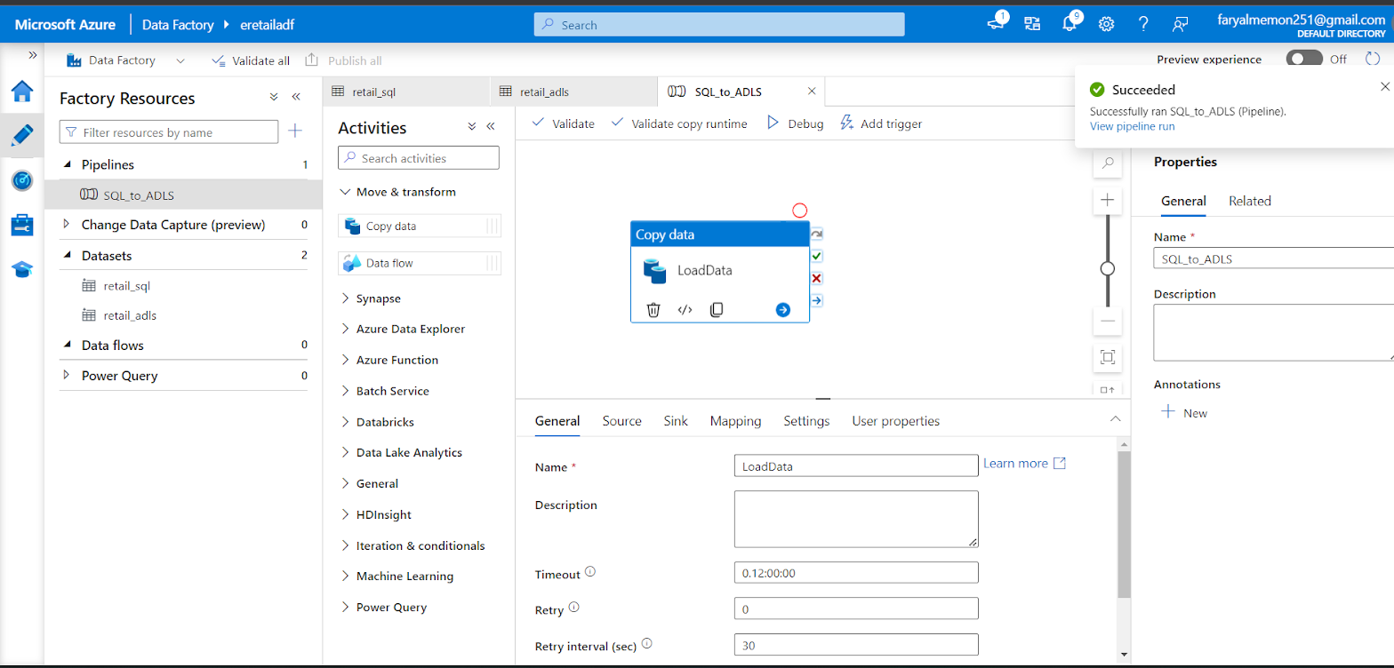
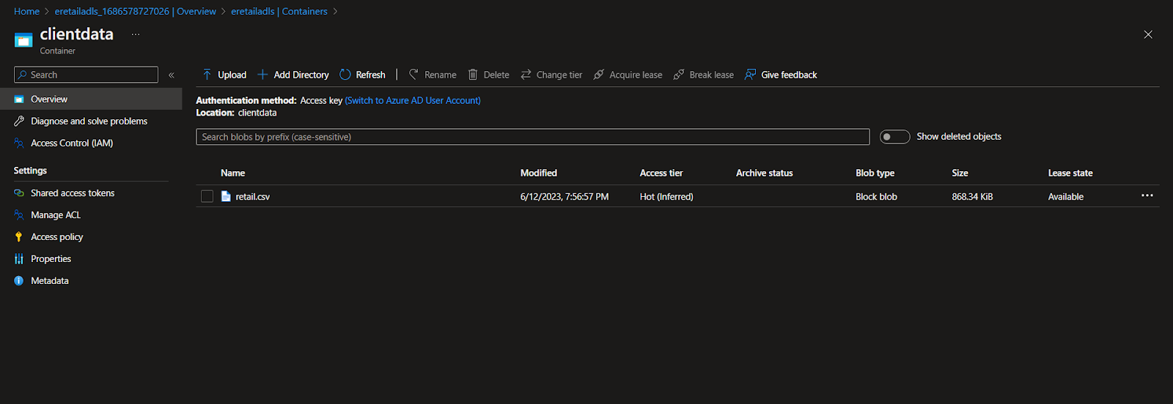
←– ADF Pipeline “SQL to ADLS” in action
ADLS Storage -—>

Slide 11
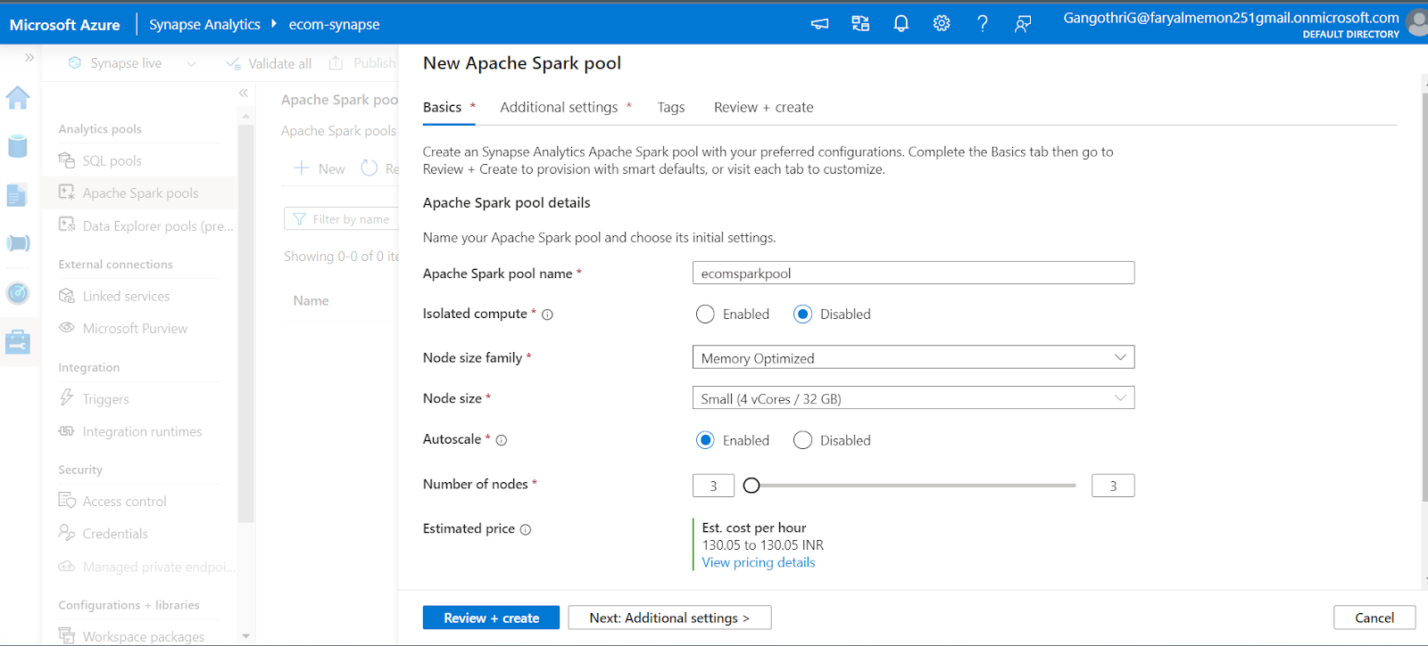
Azure Synapse
Synapse Workspace is the overall container that holds all the resources and settings related to Azure Synapse, while Synapse Studio is the web-based interface within the workspace that provides tools and features for development, management, and collaboration on Synapse components.

Slide 12
Analysis
# Loading data:
df=spark.read.load('abfss://source@retailsales123.dfs.core.windows.net/retail.csv', format='csv'
, header=True,inferSchema=True
)
# Pre-processing:
retail_df = df.withColumn('order date', to_date(col('Order Date'), 'MM/dd/yyyy'))
.withColumn('ship date', to_date(col('Ship Date'), 'MM/dd/yyyy'))

Slide 13
User Stories
User Story: Monthly Sales Report
User Story: Quarterly Sales Report
User Story: Monthly Sales Report
quarterly_sales_total_revenue = retail_df.groupBy([year("Order Date").alias("Year"), quarter("Order Date").alias("Quarter")]).agg(sum("Total Revenue")).orderBy("Year","Quarter")
monthly_sales = retail_df.groupBy([year("Order Date").alias("Years"), month("Order Date").alias("Month")]).agg(sum("Total Cost").alias("Sales")).orderBy("Years","Month")
## Output:
+-----+-----+--------------------+ |Years|Month| Sales | +-----+-----+--------------------+
| 2010| 1| 5.6117500219999984E7|
| 2010| 2| 6.149703725999998E7|
| 2010| 3| 3.2563351479999997E7|
| 2010| 4| 5.008999801000001E7|
| 2010| 5| 6.251231557999999E7|
| 2010| 6| 5.518854506000001E7|
| 2010| 7| 2.8828290519999996E7|
| 2010| 8| 5.163789438999999E7|
| 2010| 9| 4.10263253E7|
| 2010| 10| 4.209123058E7|
| 2010| 11| 3.881841093000001E7|
| 2010| 12| 5.583074315E7|
| 2011| 1| 3.531044195000001E7|
| 2011| 2| 4.8128704180000015E7|
| 2011| 3| 4.932200064999999E7|
| 2011| 4| 3.0250918640000004E7|
| 2011| 5| 5.099740488000001E7|
| 2011| 6| 4.028547157E7|
| 2011| 7| 6.0774376599999994E7|
| 2011| 8| 5.4067997589999996E7| +-----+-----+--------------------+
## Output:
+----+-------+--------------------+ |Year|Quarter| sum(Total Revenue) | +----+-------+--------------------+
|2010| 1|2.1568648214000002E8|
|2010| 2| 2.328106550899999E8|
|2010| 3|1.7718539354999992E8|
|2010| 4| 1.920828373899999E8|
|2011| 1| 1.958348384799999E8|
|2011| 2| 1.7647134479E8|
|2011| 3| 2.3487859321E8|
|2011| 4|2.3043744375999996E8|
|2012| 1|2.5948719668999994E8|
|2012| 2|2.2292645934999993E8|
|2012| 3|2.1255167141999993E8|
|2012| 4|2.0868209533999994E8|
|2013| 1|2.3419277444999996E8|
|2013| 2|1.8661791348999992E8|
|2013| 3|2.4164184929999998E8|
|2013| 4|2.4042816672000012E8|
|2014| 1|2.3005481114000008E8|
|2014| 2|2.1748007145999995E8|
|2014| 3|2.1132196698999998E8|
|2014| 4|1.9754089597000015E8| +----+-------+--------------------+

Slide 14
User Stories
User Story: Display the number of orders for each item
User Story: Display the country with highest sale
each_item = rdd_df.map(lambda l: (l[2], 1))
item_ocount=each_item.reduceByKey(add).sortBy( lambda x: x[1],ascending=False)
## Output:
[('Beverages', 447),
('Fruits', 447),
('Baby Food', 445),
('Cosmetics', 424),
('Household', 424),
('Office Supplies', 420),
('Personal Care', 415),
('Vegetables', 410),
('Meat', 399),
('Snacks', 398),
('Clothes', 386),
('Cereal', 385)]
country_order = rdd_df.map(lambda l: (l[1], l[11]))
country_revenue=country_order.reduceByKey(add).sortBy(lambda x: x[1], ascending=False)
countrywise_sales = spark.createDataFrame(country_revenue, ['country', 'sales'])
## Output:
+--------------------+--------------------+
| country| sales| +--------------------+--------------------+
| Rwanda| 6.039873958999999E7|
| Myanmar| 5.883846785E7|
| South Korea| 5.743435542999999E7|
| Ghana| 5.627138265000001E7|
| Niger| 5.529821127999998E7|
| Grenada| 5.498818455000001E7|
|Republic of the C...| 5.437980838999998E7|
| Kosovo| 5.383314279000001E7|
| Czech Republic| 5.354393214E7|
| Ukraine| 5.325231754E7|
| Vanuatu| 5.129172321E7|
item_type_orders_count = spark.createDataFrame(item_ocount, ['item_type', 'orders_count'])

Slide 15
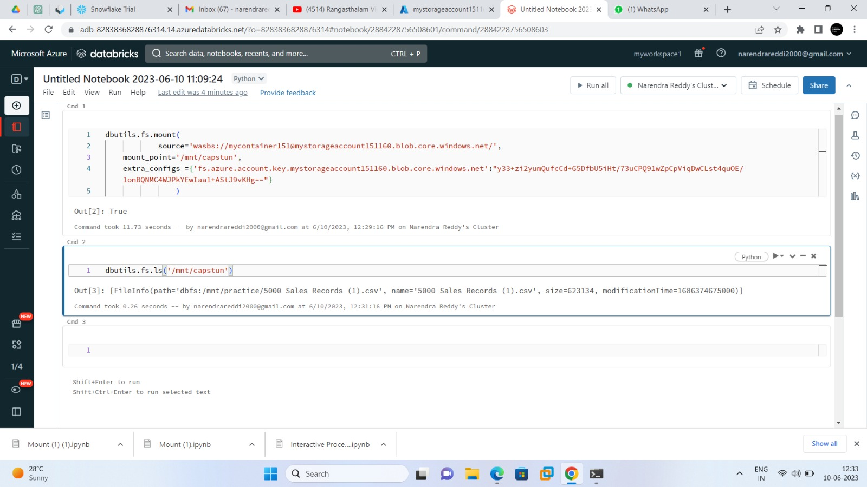
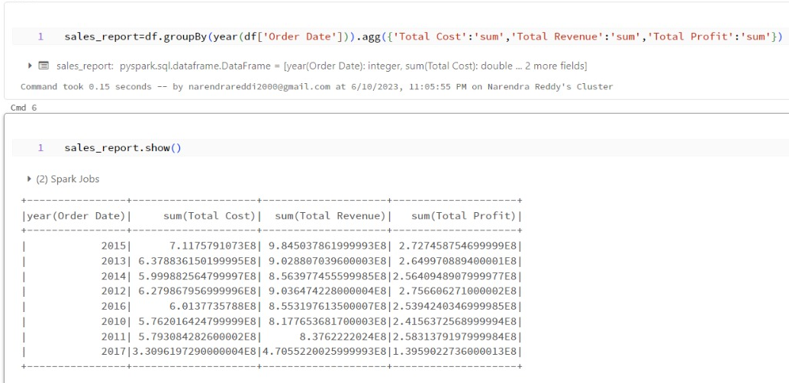
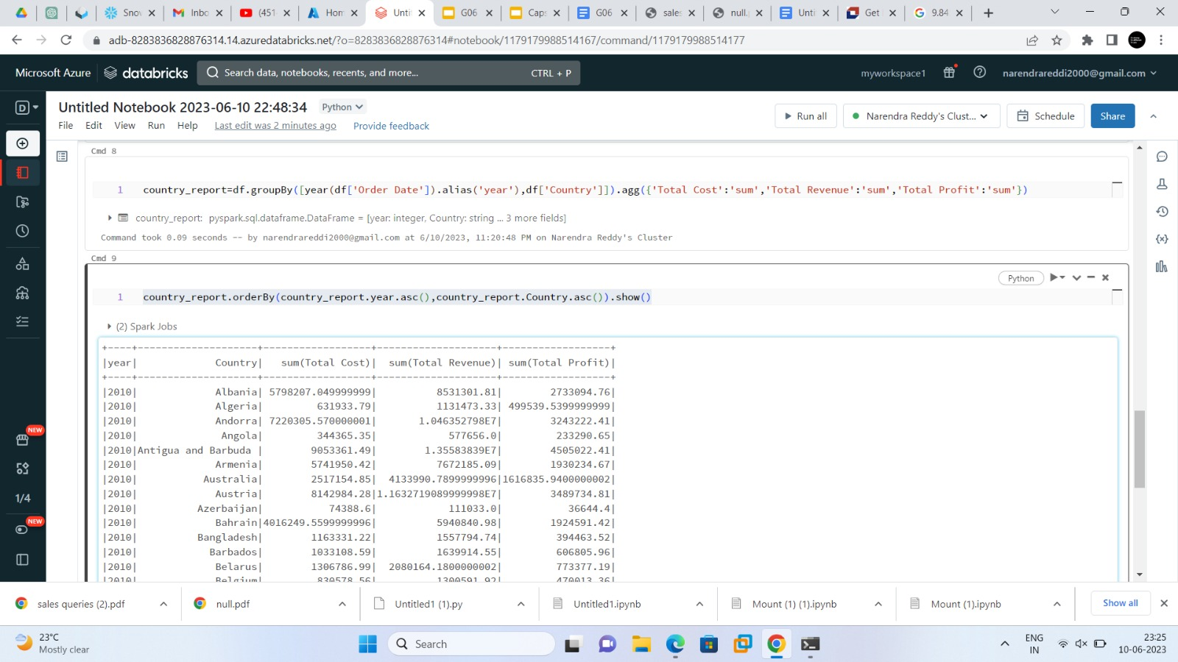
Databricks

Slide 16
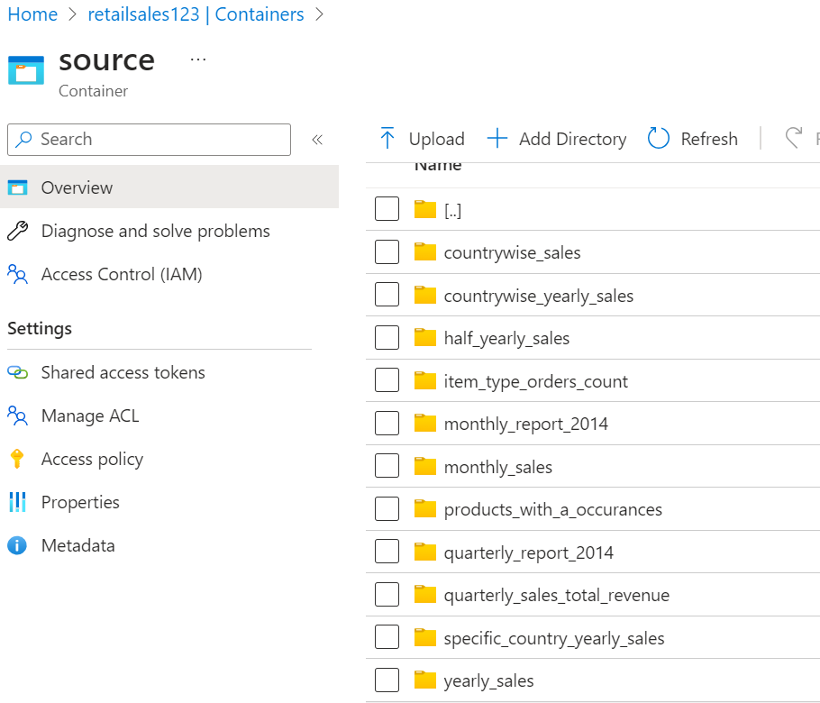
Store data
adls_account_name = "retailsales123"
adls_container = "source"
adls_folder = "output"
adls_output_path = r'abfs://source@retailsales123.dfs.core.windows.net/output/countrywise_sales'
# Save the DataFrame to ADLS
countrywise_sales.write \
.mode("overwrite") \
.csv(adls_output_path)

Slide 17
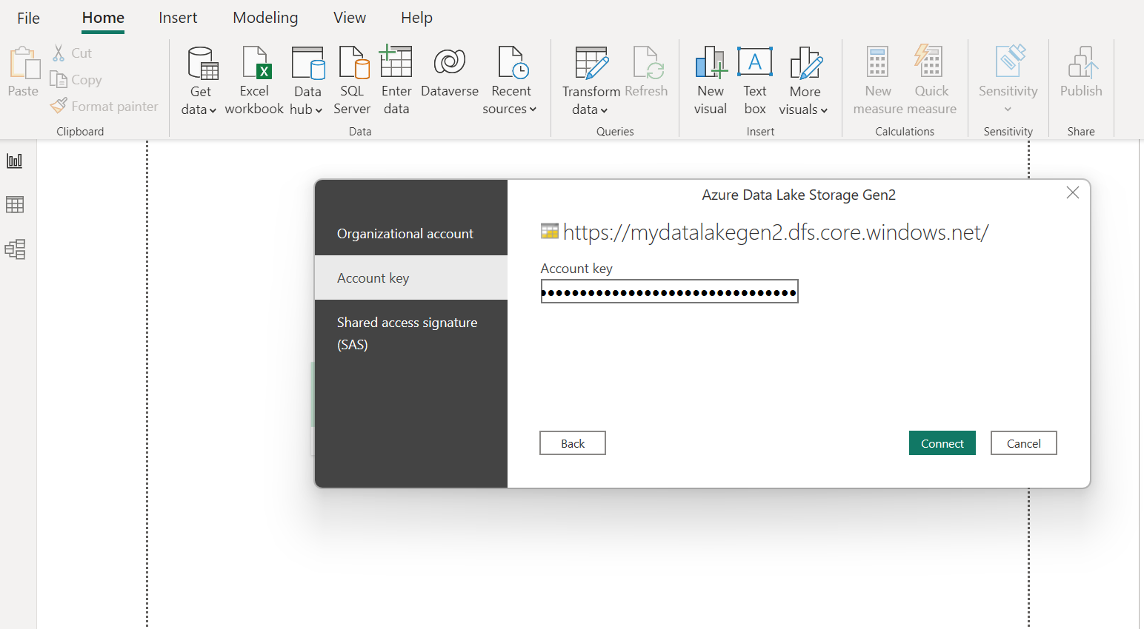
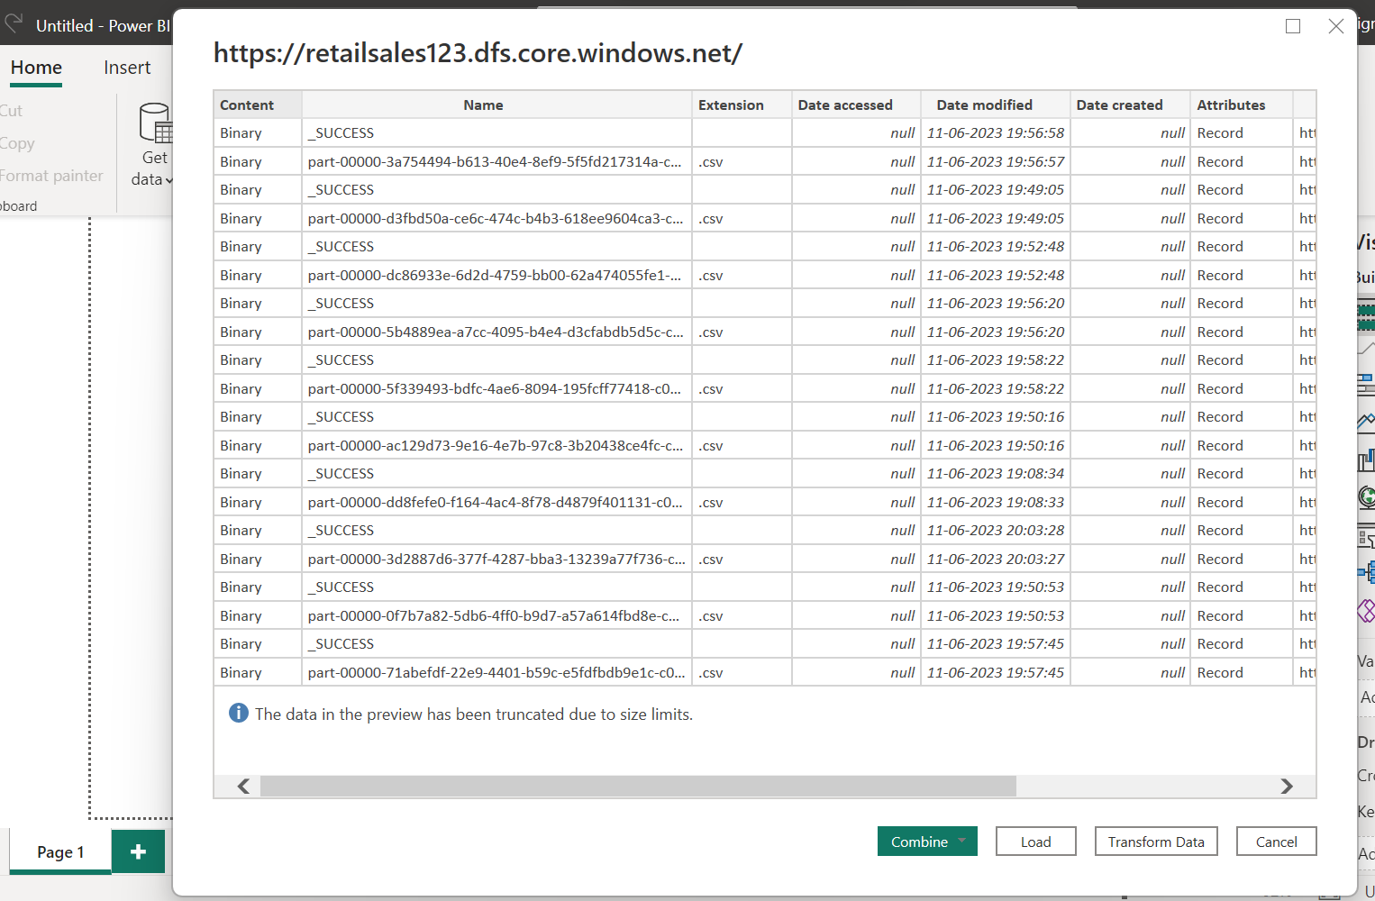
ADLS to PowerBI Desktop Connection

Slide 18
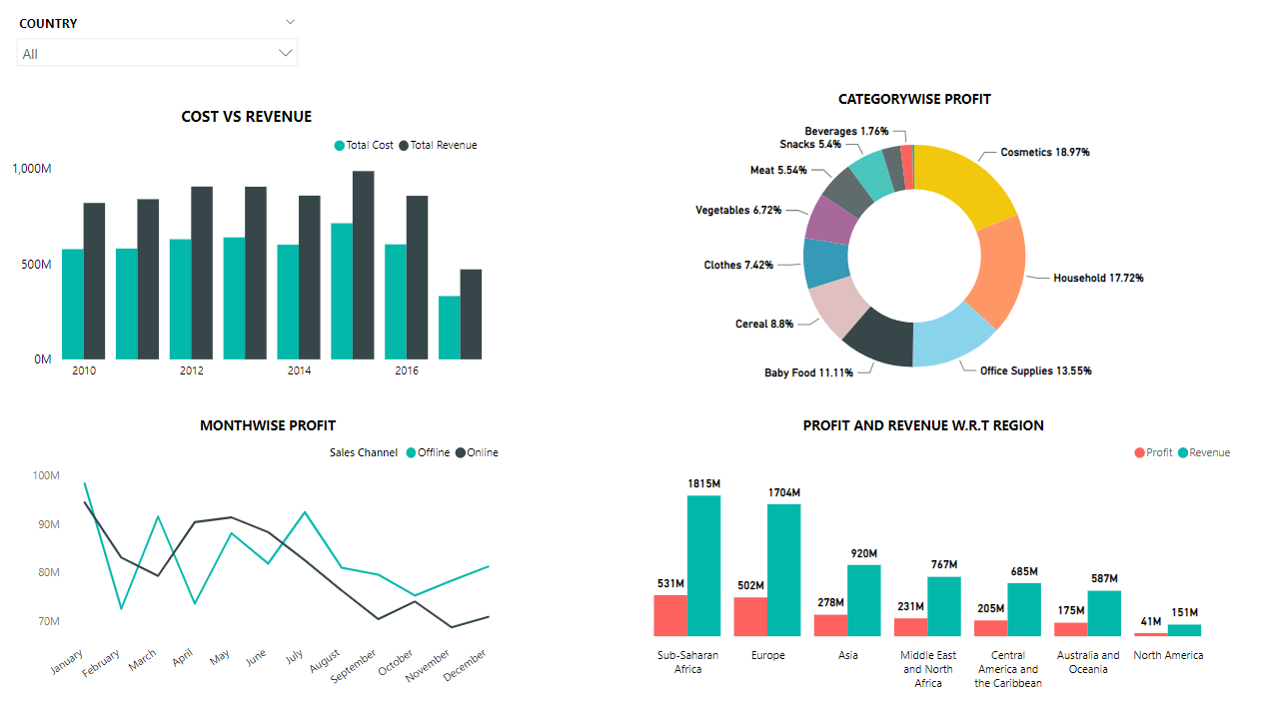
RETAIL SALES DASHBOARD

Slide 19
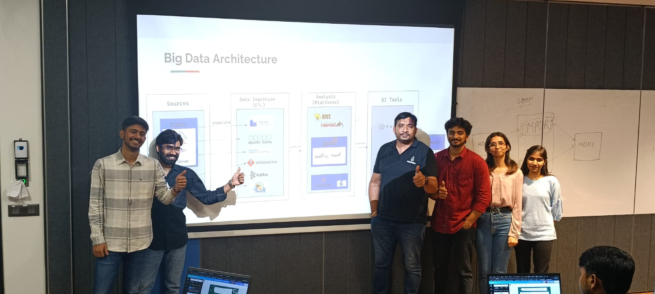
THANK YOU VENKAT SIR

